Slide 1
The Most Important Data Structures in Python
By: Iman Khani Jazani
Senior Data Scientist, Community builder | Adin
AI and Data Specialist, Business Developer | AiHum
Adjunct Professor | Sharif University of Technology

Slide 2
Last lecture
Short Presentation
Review the Last Lecture
What is data structure?
For today: lists, nested lists (nested things), and tuples
Can we create a new data structure?
Programming with Python IDLE
Application of Programming in the Digital Age!

Slide 3
Today
Short Presentation
What is data structure?
For today: dictionary, set, nested of all things
Programming with Python IDLE
Application of Programming in the Digital Age!

Slide 4
Together
Send your feedback about the class whenever you want!

Slide 5

Contact me
Gmail: ImanKhaniJazani@gmail.com
LinkedIn: https://www.linkedin.com/in/ImanKhaniJazani/
Telegram: @IKJ1992

Slide 6
Short Presentations

Slide 7
Review the Last Lecture

Slide 8
What is Data Structure?

Slide 9
Definition
An organization of data for the purpose of making it easier to use.
Algorithm
Data Structure
Program

Slide 10
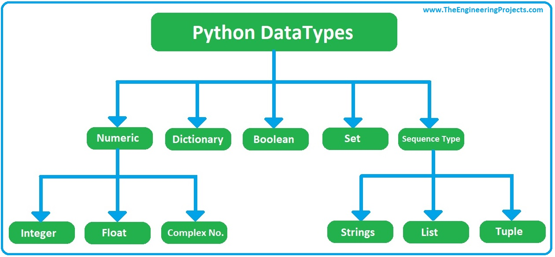
Python DataTypes

Slide 11
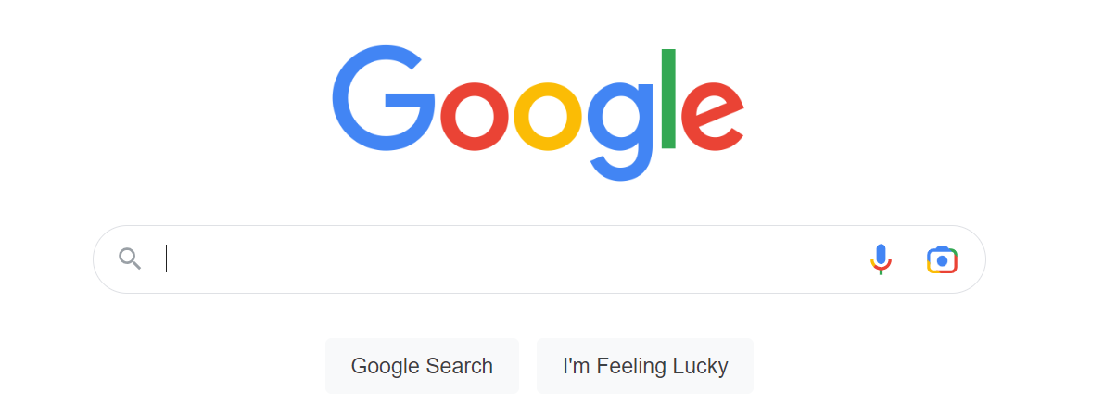
Dictionary

Slide 12
Set

Slide 13
Nesteds!
List of dict
Dict of list
Tuple of dict
Tuple of dict of list
List of list of list of list
…

Slide 14
Programming with Python IDLE

Slide 15
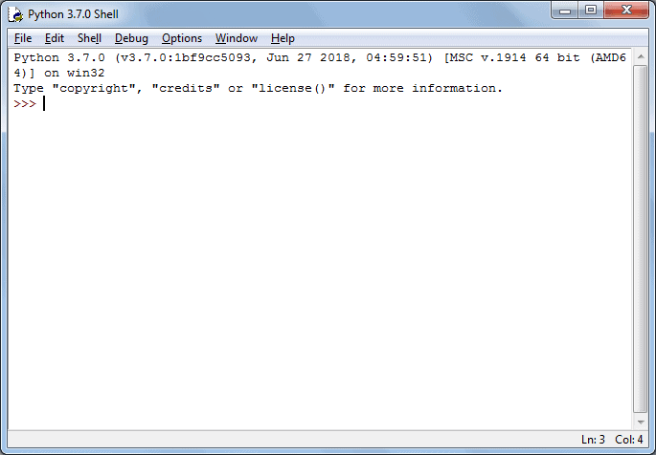
Let’s go for prompt-based coding…

Slide 16
Application of Programming in the Digital Age!

Slide 17
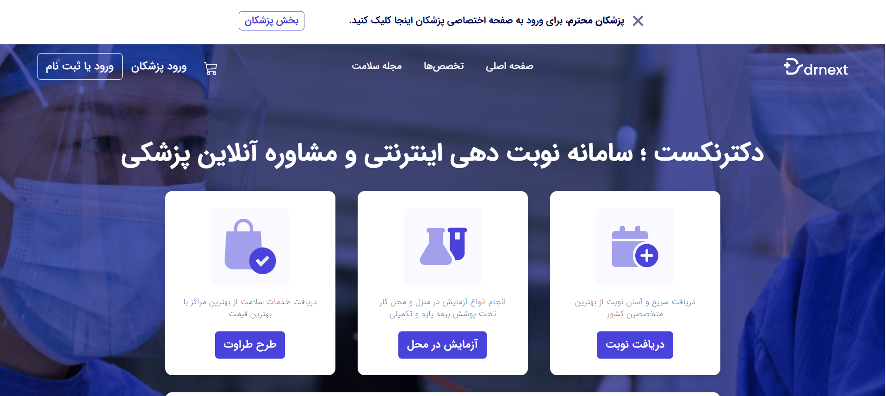
Drnext

Slide 18

Programming a simple DrNext!
ثبت و ویرایش بیمار
ثبت و ویرایش مرکز درمانی
جستجوی بیمار بر اساس نامش
جستجوی بیمار بر اساس مشخصات
جستجوی مرکز درمانی بر اساس نامش
جستجوی مرکز درمانی بر اساس مشخصات
نوبت‌دهی بیمار بر اساس مرکز درمانی انتخاب شده توسط بیمار
...
Notes:
Problem definition and step by step solving…
Modular structure of our project trying to comment our code! Nested (dict of list)
Working with strings
Break and continue
Functions with return statement
Do you have any idea to make a better DrNext?

Slide 19
Lecture Resources
P. Wentworth, J. Elkner, A. B. Downey, C. Meyers. How to Think Like a Computer Scientist: Learning with Python. 3rd Edition, Open Book Project, 2011.

